Slide 1
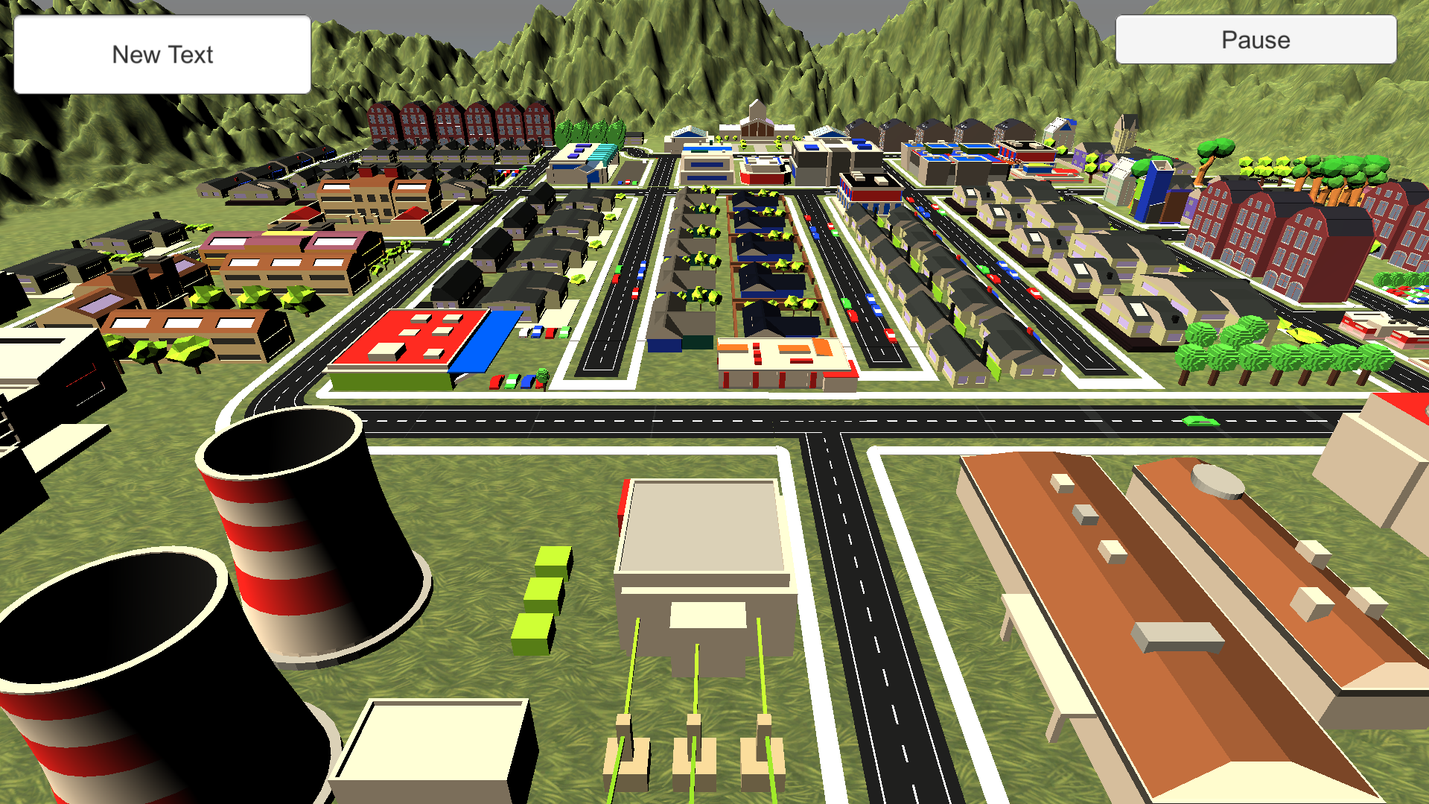
Player: Sam Score: 500
Close
Current Problems
workers available: 1
Problem Time Remaining Workers deployed
Add
A customer needs his meter readings taken. 2:00 2
1 / 3
$ 50000
☹ ☺

